Slide 1

Outdoor Environmental Monitoring Using an Internet-of-Things System

Slide 2

Course Code: CSD430 B.Tech Project
Mode of project: A
Dr. Debopam Acharya
Associate Professor and Head Department of Computer Science and Engineering School of Engineering Email Contact: debopam.acharya@snu.edu.in
Bharat Vaidhyanathan bv923@snu.edu.in 1210110044
Jitesh Aggarwal ja923@snu.edu.in 1210110089

Slide 3


Executive Summary
To tackle rising air pollution in metropolitans, first step is to make people aware of the problem. We have developed an IoT system, using participatory/crowd sensing mechanism. It collects several environmental data, analyses it and observes the effect of a large subset of the environmental data caused by vehicular emission.

Slide 4
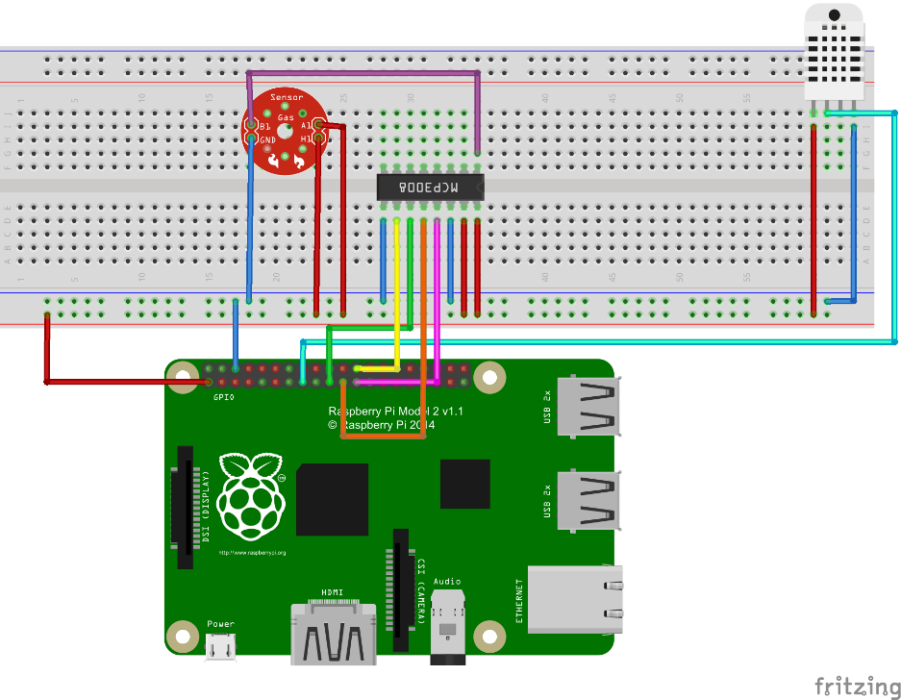
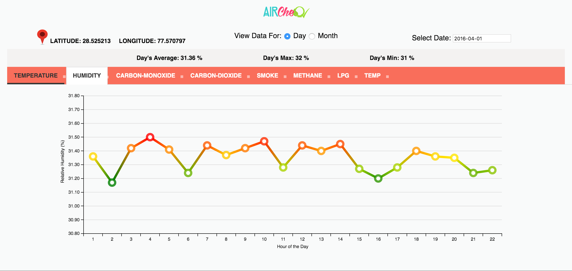
Introduction
What?
AirCheQ is an complete one-stop solution for collecting, displaying, and sharing outdoor Air Quality Data
|Hardware Setup with Sensors |AirCheq Android App |AirCheQ Website
Notes:
The platform consists of a hardware setup equipped with a set of generic sensors that detect various gases and other environmental measures, the AirCheq Android App and the AirCheQ website.
By collecting AQ data and other environmental measures and displaying it to inform personal decision-making and public policy, the

Slide 5
Introduction
Why?
To bring about a behavioural change
Inter-disciplinary aspect of the project
To develop a general purpose IoT platform to customize it according to one’s own needs by using generic set of sensors at our disposal
Build something that really matters and could be scaled later for future use
Notes:
The platform consists of a hardware setup equipped with a set of generic sensors that detect various gases and other environmental measures, the AirCheq Android App and the AirCheQ website.
By collecting AQ data and other environmental measures and displaying it to inform personal decision-making and public policy, the

Slide 6
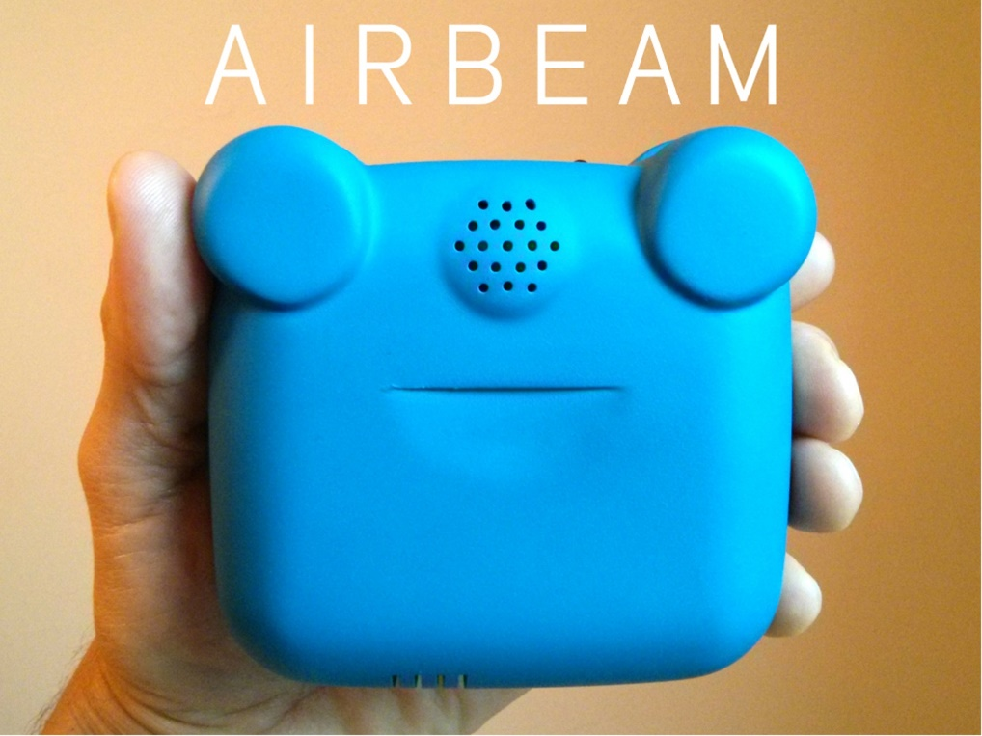
Related Work
There have been various attempts at building system that help us monitor External environment based
on different parameters
AirCasting
AirBeam measures data of PM2.5 concentrations
AirCasting Android app
Maps and graphs the data in real time on your smartphone
Air Quaity Egg
Sensor system designed to allow anyone to collect very high resolution readings of NO2 and CO concentrations
Website with map to display data from egg locations around the world.
Notes:
RediffLabs
Portable Environmental Monitor (Uses Atmega)
TZOA
Lapka PEM
Clarity PM2.5
microAet (Black carbon aerosol Monitor)

Slide 7
Overview
To serve as a prototype for a crowd sourced external environment monitoring system
The setup collects, stores and upload data to the server.
A Web service that acts as an interface between the UI and the DB.
Data is analyzed and displayed in a simple and meaningful UI for both Web and the Android App.
Image: A high-level diagram of the IoT setup used
Notes:
To deliver a fully working IOT setup, along with server and mobile application, hardware and software support.

Slide 8
Related Work
The Team
Dr. DEBOPAM ACHARYA
Project Mentor
BHARAT VAIDHYANATHAN
Project Developer
JITESH AGGARWAL
Project Developer
Name | Hardware Designer | Algo Design | Coding | Debugging | Documentation
Bharat |  | ✓ | ✓ | ✓ | ✓
Jitesh | ✓ |  | ✓ | ✓ | ✓

Slide 9
Domain Analysis
The team researched and did analysis on the available technologies that needed to be acquired or used:
Onboard Computer (Raspberry Pi 2 Mod B, Arduino Mega 2560)
Remote Communication (WiFi, 3G Dongle, Bluetooth)
GPS Receiver(Bluetooth GPS Receiver, GPS Module)
Temperature and Humidity Sensor (Combined Sensor, Separate Sensor)
Gas Sensors (MQ-x Gas Sensor Modules, MQ-x Gas Sensors)
Analog to Digital Converter (MCP3008, ADC0809, Arduino Uno/Mega)
Web User Interface & Database Technology (Meteor 1.2.1, LAMP)

Slide 10
Risk Analysis
Risks were analysed and solutions were developed to counter the same:
Sensors (Testing for prolonged periods of time)
Wireless Communication (TCP, Connection problem & reconnect)
ADC Failover (Arduino as a backup for MCP3008)
GSM GPRS Module (High power consumption, Inconviniently big, low speeds)
GPS Module (High power consumption)

Slide 11
Sensors Used
Gas Detected | Sensor(s) used to detect
Carbon Dioxide | MQ135
Smoke | MQ2
Methane | MQ4
LPG | MQ6
Carbon Monoxide | MQ7, MQ9
Water vapor | DHT22

Slide 12
Software and Hardware Requirements
Software Requirements:
Java SE (Oracle JDK 8)
Java EE (Oracle JDK 8)
Python (v2.7)
Meteor (Full Stack of Blaze and MongoDB) (v1.2.1)
Android Studio (v1.5.1)
Hardware Requirements:
Core Setup Requirements
Sensing Requirements
(DHT22 and MQ-x sensor modules)
Tenda USB WiFi Module
Belkin USB Bluetooth Adapter
MTS USB Data Dongle
Server Machine / Cloud
Other Electronic Requirements
(Power Bank, Sensordrone, Android Smartphone)

Slide 13
Hardware Setup
Setting up the Raspberry Pi
Interfacing the Sensors
Interfacing the Analog to Digital Converter (MCP3008)
Calibrating the MQ-x Sensors
Setting up the GPS Module and Bluetooth
Calculating the Geolocation from NMEA Messages

Slide 14
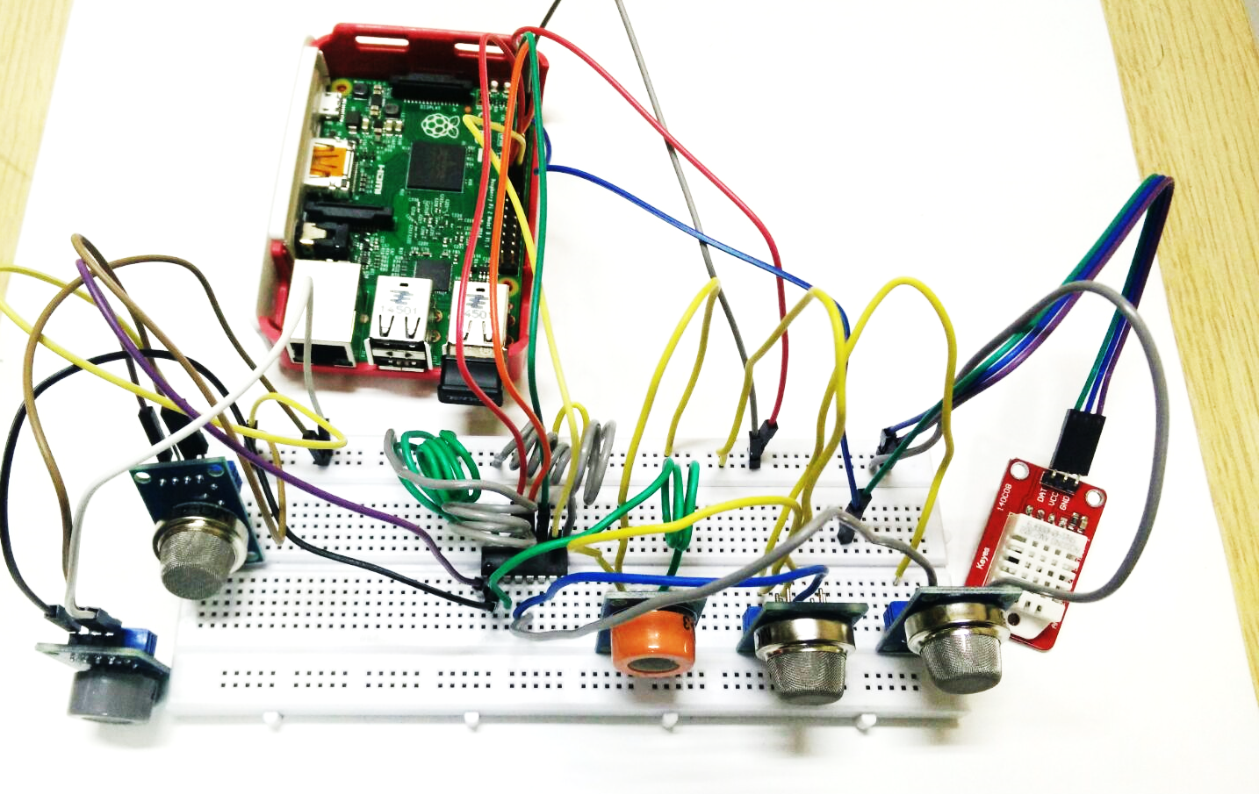
WiFi Module
Raspberry Pi 2 ModB
ADC3008
MQ3 Sensor
MQ2 Sensor
MQ4 Sensor
DHT22
MQ7 Sensor
MQ1 Sensor
Image: A basic hardware setup to read MQX sensor from channel 1 of ADC3008 and DHT22 readings directly from GPIO pins of Raspberry Pi 2 Mod B

Slide 15
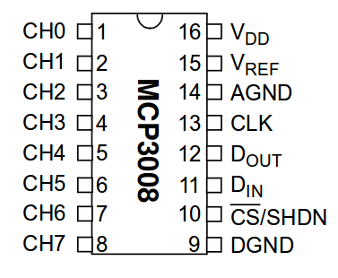
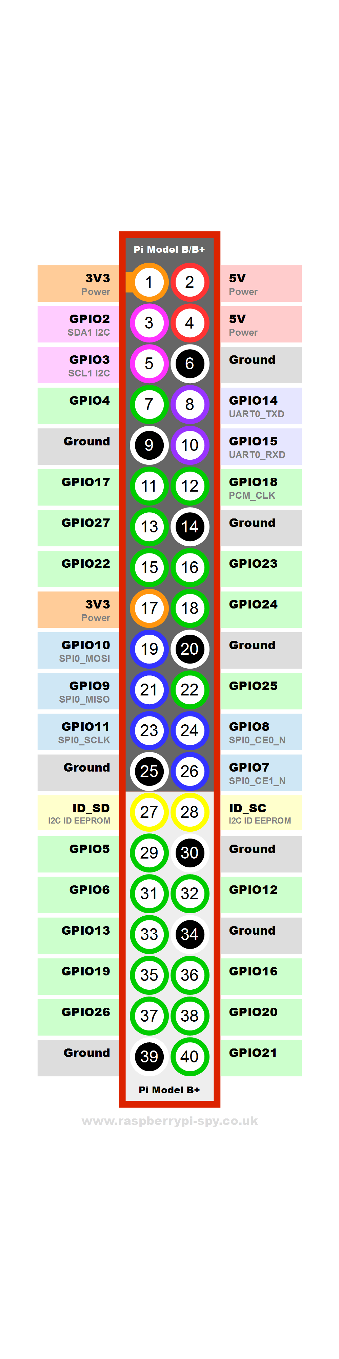
Image: Pin Diagram of ADC MCP3008 (left) and Raspberry Pi 2 (right)

Slide 16
Web System Setup
Meteor
Map View
Graph View
Java Web Service
Glashfish server which hosts HTTP GET Methods
Methods for returning DB Data, Distinct LatLongs, Average, Max and Min.
MongoDB

Slide 17

4
MONTHS
10
MENTOR MEETINGS
16
BI-WEEKLY MEMBER MEETINGS
0
Bi-weekly
Member Meetings
10 Mentor Meetings
No Absentees
ABSENTEES

Slide 18
Timeline

Slide 19
LIVE DEMO

Slide 20



Milestones Completed
Setup Raspberry Pi with Raspbian OS with desired configuration
Basic hardware setup
A working webserver with a DB using both MySQL and Meteor
Feasibility Study
Necessary Background Research
Mobile App Integration
Making the data context aware using aggregation
Calibrate the sensors to sense the vehicular emission
A refined UI for the webserver
Testing for a fully functional crowd-sensing platform
User Manual/ Report
Notes:
Basic hardware setup of the sensors (both analog and digital) able to sense and write to the terminal
A working webserver with a DB able to communicate with the Raspberry Pi setup using both MySQL and Meteor

Slide 21
Milestones Completed
Setup Raspberry Pi with Raspbian OS with desired configuration
Feasibility Study & User Manual/ Report
Android Mobile App Integration
Making the data context aware using aggregation
Calibrate the sensors to sense the vehicular emission
A working webserver with a DB using Meteor’s Mongo
A refined UI for the webserver (Meteor JS + CSS)
A working Java EE Web Service acting as an interface between the UI and the DB

Slide 22
Project Experience
The Good:
Learnt new technologies
Inter-disciplinary project
Scheduled Approach
Maintained a project diary
The work load equally distributed
Were able to scale the project from WiFi to GSM
Hurdles faced:
Getting the ADC required
Connection interrupted problem
Calibrating the gas sensors
GPRS Module and Raspberry Pi Failure
Improvements:
Build app for iOS too.
Develop it as a commercial project
Deeper Analytics

Slide 23
ACKNOWLEDGEMENTS

Slide 24
References
Sun, W., Li, Q., & Tham, C. K. (2014). Wireless Deployed and Participatory Sensing System. 2014 SECON Demos (pp. 158-160). Singapore: IEEE International Conference on Sensing.
Zanella, A., Bui, N., Castellani, A., Vangelista, L., & Zorzi, M. (2014). Internet of Things for Smart Cities. IEEE INTERNET OF THINGS JOURNAL, 22-32.
Aircasting.org, (2016). AirCasting. [online] Available at: http://aircasting.org/ [Accessed 5 Jan. 2016].
Airqualityegg.com, (2016). Air Quality Egg. [online] Available at: http://airqualityegg.com/ [Accessed 5 Jan. 2016].
Rediff, (2016). Real time air quality monitoring for Delhi. [online] Available at: http://www.rediff.com/news/report/rediff-labs-real-time-air-quality-monitoring-for-delhi/20160201.htm [Accessed 11 Feb. 2016].

